Slide 1

Computer Programming for Engineers
Week 1 Lecture 1
Aug. 30, 2022
Lecturer: Mohammad Mahdi Javidan
College of Engineering, Sungkyunkwan University
Fall Semester 2022

Slide 2
Introduction
Course name: Computer Programming for Engineers
Lecturer: Mohammad Mahdi Javidan, PhD in Structural Engineering
Affiliation: Postdoctoral researcher at Seismic Design and Retrofit Lab
Email: javidan@skku.edu
Schedule: 15 weeks, Tuesday 16:30 - 17:45, Thursday 15:00 - 16:15
Evaluation: Team Project 30%; midterm exam 35%; final exam 35%
Attendance: According to the administration office, at least 3/4 of classes should be attended
Covid-19!: Fill out the self-report through Kingo Portal! 7 days of attendance are confirmed according to the administration office
Orientation: https://forms.gle/aCdSXfiXLyU3fEZ58
College of Engineering, Sungkyunkwan University

Slide 3
Introduction
Topics
Introduction, data types, operations, and expressions
Algorithm development, branching, iteration: Algorithm, flowchart, branches, loops, etc.
User-defined functions, plotting and data visualization, Taylor series
Numerical methods for solving nonlinear functions: bisection method, Newton’s method, etc.
Linear algebra and systems of linear equations
Complexity & I/O functions: Efficiency of algorithms, and data management
Recursions and Monte Carlo simulation: Fundamentals of MCS, Classic recursion problems: Hanoi tower, etc.
Least squares regression: Theory and application of least squares fitting
Interpolation methods: Newton, Lagrange
Numerical Differentiation: Finite difference, high accuracy estimations
Numerical integration: Newton-Cotes integration, Gauss Quadrature, etc.
Solving ordinary differential equations (ODE): Euler, Heun, & Runge-Kutta methods, etc.
References
Q. Kong, T. Siauw, Bayen A. M., “Python Programming and Numerical Methods” Academic Press, 2021.
https://pythonnumericalmethods.berkeley.edu/notebooks/Index.html
Steven C. Chapra, Raymond P. Canale, (2021) Numerical Methods for Engineers, McGraw-Hill
College of Engineering, Sungkyunkwan University

Slide 4
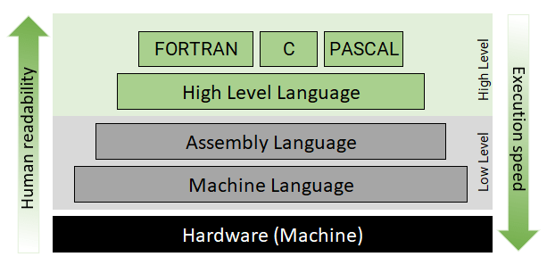
Python!
Python is:
A high-level
Dynamic typing
Object-oriented
Open source and free
programming language
Binary codes understood by CPU
College of Engineering, Sungkyunkwan University

Slide 5
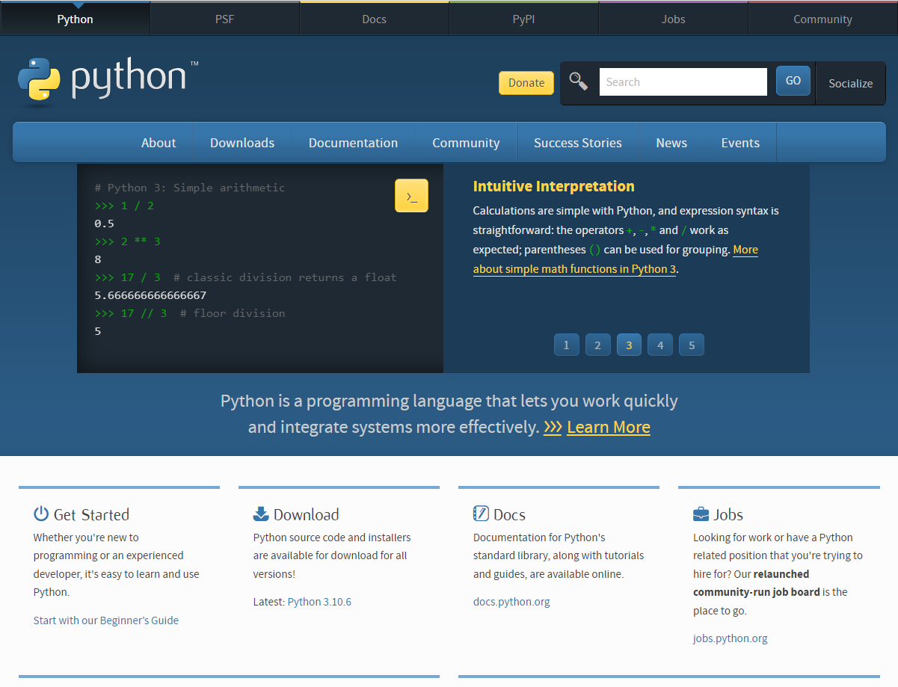
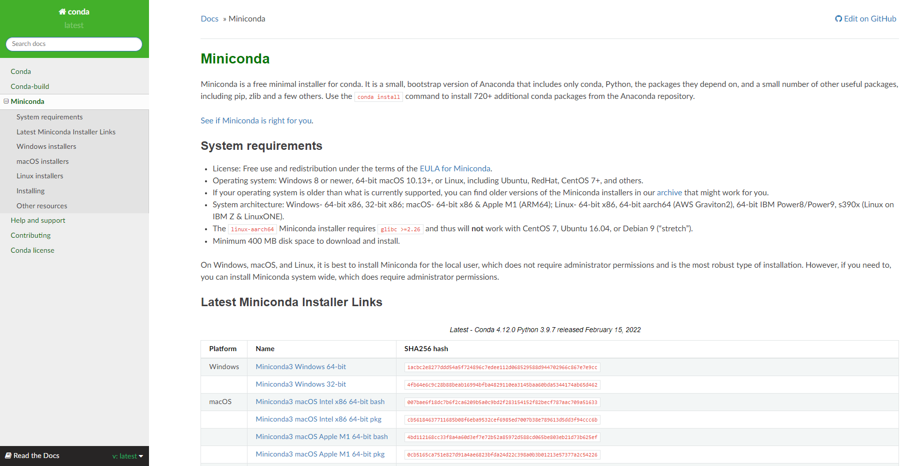
Installation
Installation
Anaconda or Miniconda
https://docs.conda.io/en/latest/miniconda.html
https://www.python.org/
Microsoft store
pip command is used to install packages
You might need to install it!
College of Engineering, Sungkyunkwan University

Slide 6
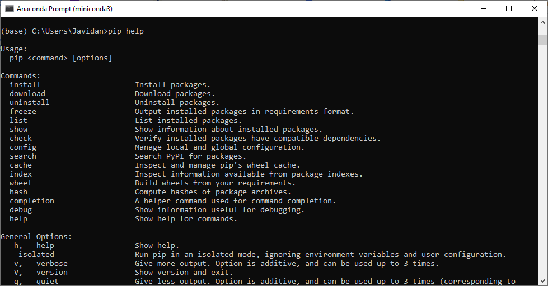
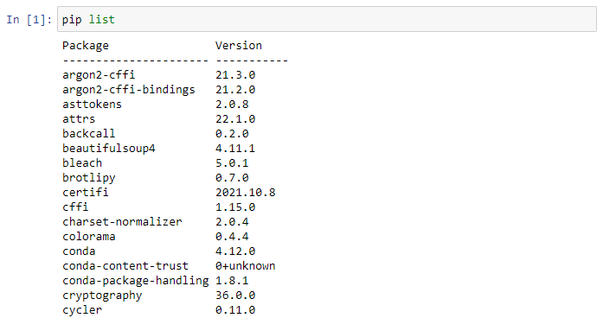
Managing Packages
Installation
In case it is not properly installed, download the code
https://bootstrap.pypa.io/get-pip.py
Type in Command Prompt where you saved the file:
python get-pip.py
Common commands
pip help
pip list
pip install package_name
pip show package_name
pip uninstall package_name
Required packages
ipython, numpy, scipy, pandas, matplotlib, jupyter notebook
College of Engineering, Sungkyunkwan University

Slide 7
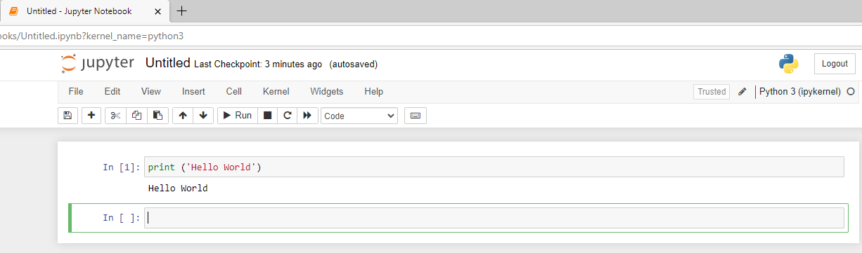
Running Python Code
Jupyter Notebook
Type in Anaconda Prompt:
pip install jupyter notebook
jupyter notebook
Command Prompt
Save your codes in a text file
Execute them in Command Prompt as:
python myCode.py
IPython shell or Python shell
Online compilers
https://www.online-python.com/
Jupyter Notebook helps you create, manage, and share your codes, visualizations, statistical modeling, etc.
It opens in the current directory of Anaconda Prompt
cd address
College of Engineering, Sungkyunkwan University

Slide 8
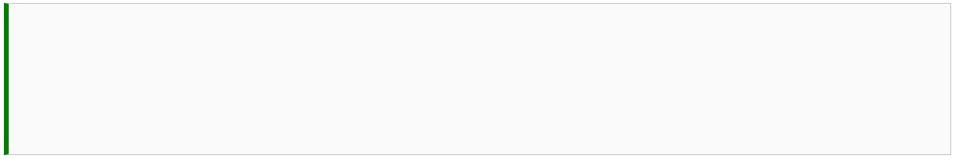


Arithmetic Operations and Operators
Enter in Python Shell
Shift+Enter in Jupyter Notebook
Reserved symbols by Python:
** Exponentiation
* Multiplication
/ Division
// Floor division
% Modulo
+ Addition
- Subtraction
↵
Order of operations
College of Engineering, Sungkyunkwan University

Slide 9





math Module
Most common arithmetic functions:
sin
cos
tan
exp
log
log10
sqrt
etc.
$$e^{ln⁡(10)}=10$$
Analytical solution
Simpler way to use an imported
function:
from math import sin, log, pi
Numerical solution
College of Engineering, Sungkyunkwan University

Slide 10






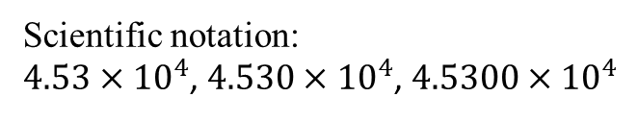
Data Types
Scientific notation:
$4.53×{10}^{4}$, $4.530×{10}^{4}$, $4.5300×{10}^{4}$
Complex numbers
Numeric types:
int
float
complex
College of Engineering, Sungkyunkwan University

Slide 11




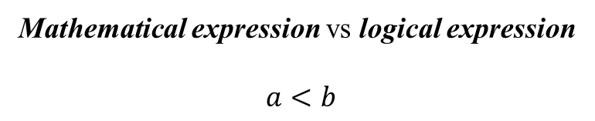
Logical Expressions and Operators
Mathematical expression vs logical expression
$$a<b$$
Boolean type built-in values:
True
False
Reserved symbols by Python:
> greater than
>= greater than or equal
< less than
<= less than or equal
!= not equal
== equal
College of Engineering, Sungkyunkwan University

Slide 12
Logical Expressions and Operators
logical operators
and P and Q True if both P and Q are True. False otherwise
or P or Q True if either P and Q are True. False otherwise
not not p True if P False. False if P is True
Does (P AND NOT(Q)) OR (P AND Q) depend on Q?
All arithmetic operations are executed before logical expressions, but it can be prioritized using parentheses.
* Boolean algebra is a more wider subject and is not within the scope of this course
College of Engineering, Sungkyunkwan University

Slide 13
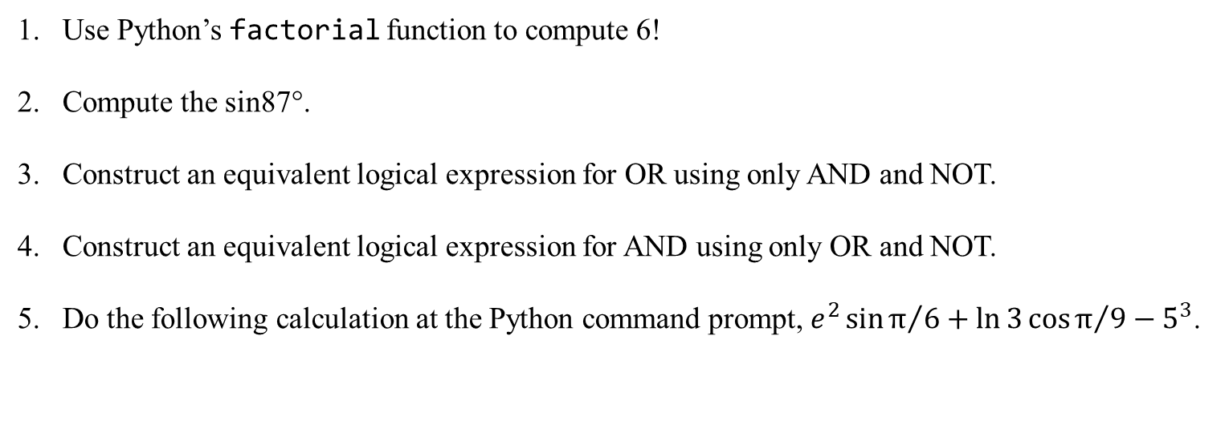
Assignment 1
Use Python’s factorial function to compute 6!
Compute the sin87°.
Construct an equivalent logical expression for OR using only AND and NOT.
Construct an equivalent logical expression for AND using only OR and NOT.
Do the following calculation at the Python command prompt, $e^{2}\sin{π/6}+\ln{3}\cos{π/9}−5^{3}$.
College of Engineering, Sungkyunkwan University

Slide 14
Assignment 1
Answer: P OR Q = NOT(NOT(P) AND NOT(Q))
Answer: P AND Q = NOT(NOT(P) OR NOT(Q))
P | Q | NOT(NOT(P) AND NOT(Q))
1 | 1 | 1
1 | 0 | 1
0 | 1 | 1
0 | 0 | 0
Truth table
P | Q | NOT(NOT(P) OR NOT(Q))
1 | 1 | 1
1 | 0 | 0
0 | 1 | 0
0 | 0 | 0
College of Engineering, Sungkyunkwan University

